Slide 1
Tariff calculation

Slide 2
CODE EXPLANATION
Header Files:
The code includes two standard C library header files, `<stdio.h>` and `<stdlib.h>`, which are used for input/output operations and dynamic memory allocation, respectively.
Struct Definition:
A structure named `Consumer` is defined to store information about each consumer.
calculateTariff Function:
This function calculates the electricity tariff based on the consumer's type and time of usage. It takes a pointer to a `struct Consumer` as an argument and updates the `tariff` member of the structure.

Slide 3
MaIN FUNCTION
main Function:
The main function is the entry point of the program. It performs the following tasks:
- Reads the number of consumers from the user.
- Dynamically allocates memory to store an array of `struct Consumer` based on the number of consumers entered.
- Reads consumer information (name, type, time, and energy consumption) from the user and calculates the tariff for each consumer using the `calculateTariff` function.
- Displays the calculated tariffs for each consumer.
- Frees the dynamically allocated memory before exiting the program.

Slide 4
Requirements for tariff calculation
Consumer Information: The code expects information about each consumer, including Name, Type, Time , Energy Consumed.
Tariff Calculation Logic: The code calculates the electricity tariff for each consumer based on their type and the time at which the load is required.
Displaying Tariffs: After calculating the tariff for each consumer, the code displays the calculated tariffs, including the consumer's name, type, and the calculated tariff in dollars.
Memory Allocation: The code dynamically allocates memory for an array of `struct Consumer` based on the number of consumers provided by the user. It checks for memory allocation failures and exits if allocation fails.

Slide 5
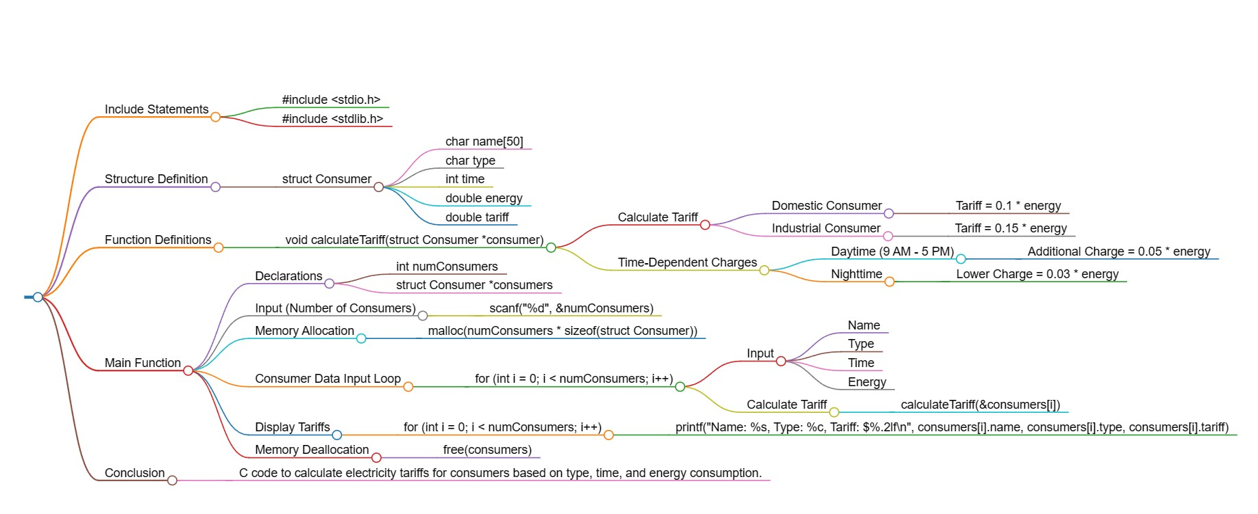
Mind map

Slide 6
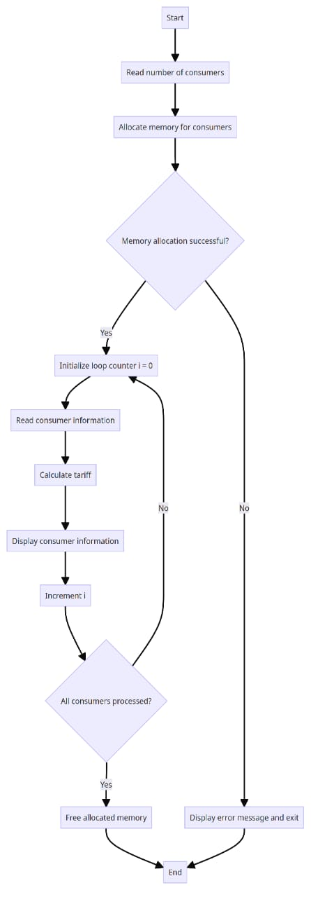
Flow-chart

Slide 7
Uses of tariff calculation
Billing and Invoicing: Tariff calculations are used by electricity providers to generate bills for consumers. The tariff determines the cost of electricity based on usage, time of use, and other factors. Consumers receive invoices or bills that detail their electricity consumption and associated charges.
Revenue Generation: Electricity providers rely on tariffs to generate revenue. The tariffs are designed to cover the costs of producing and distributing electricity, as well as to ensure a profit for the provider. Accurate tariff calculations are essential for the financial health of energy companies.
Cost Allocation: Tariffs help allocate the costs of generating and distributing electricity among different consumer classes, such as residential, commercial, and industrial customers. This ensures that each group pays a fair share of the infrastructure and operational costs.
Regulation and Compliance: Regulatory bodies often use tariff calculations to set pricing standards, ensure fair competition, and protect consumer interests

Slide 8
Explaining the concept of tariff calculation
Cost Recovery: Tariffs are designed to recover the costs incurred by electricity providers in generating, transmitting, and distributing electricity. These costs include infrastructure maintenance, fuel, labour , and more.
Consumer Categories: Tariffs can vary for different types of consumers, such as residential, commercial, and industrial. Each category may have specific pricing structures to reflect their unique needs and usage patterns.
Rate Structure: Tariffs have a rate structure that defines how charges are calculated. It may include fixed charges (regardless of usage), variable charges (based on consumption), and time-of-use rates (prices vary depending on the time of day).
Regulation: Electricity tariffs are often subject to government regulation to ensure fairness and affordability. Regulatory bodies review and approve tariff proposals to protect consumers.

Slide 9
THANK YOU

